Slide 1
VHC – Marketing & Communicatie
Sprint Demo : 2023 - 05 – 01

Slide 2
Roadmap
Our name 101
WWW: Overview of the story, Overview of the tools we have, the things you can do with us, linkedin and basic SM. Tools
Work Adventure 1.0 : digital office; Community Chatting: Intergrate with some forum.
Getting out there
SEO machine to look for partners
Automatic Onboarding systems
Online created content
Upgrading
Finalized stable version
Handover
CRM system Intergrated

Slide 3




Table of Contents
1- SPRINT GOAL
2- STATUS
3- DEMO
4- FEEDBACK

Slide 4
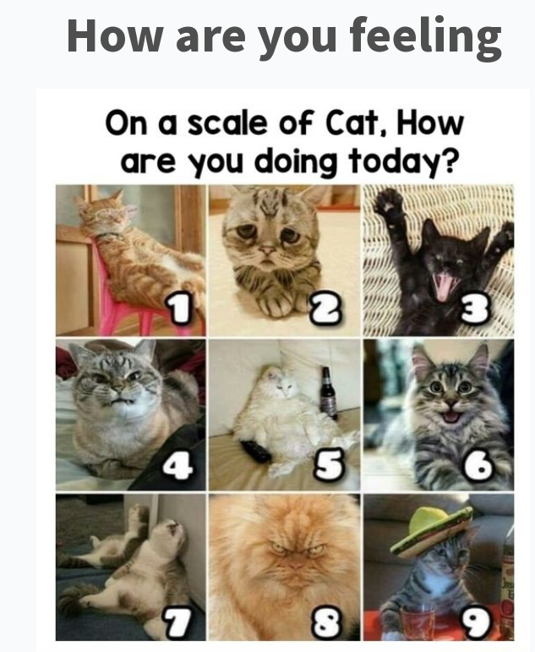

Slide 5
What were the goals this sprint

Slide 6
BackLog Ideas
Add minecraft to the work adventure
Run Work adventure ourselves, on a managed github with CI/CD
Create an monitoring system for all the tools, website etc, to see if it's up
Add bookdown and Blogdown to intergrate together

Slide 7



WebSite:
Create a first website for our iniative
WireFrame:
First Process Flow First few goals
Community:
Setup first work adventure, and intergrate it.
Scrum Management:
Integrate into Clockify

Slide 8
Cumulative Flow Diagram

Slide 9


🏗️DEV
🎨DESIGN
🏉ADMIN/SCRUM
🤝BD
TASK
Direct value
Enablers
🏗 Setup Sprint Demo in Advance: Split meeting
🏗️ Added Ayoub to the Clockify
🏗️ Made tasks for him in the planning board
🏗️ Created Scrum Tasks
🏗️
🏗
🏗️ Goal set already before we start, working towards goal only.
🏗️ Making sure Ayoub knows what he is working towards.
🎨

Slide 10

Demo

Slide 11
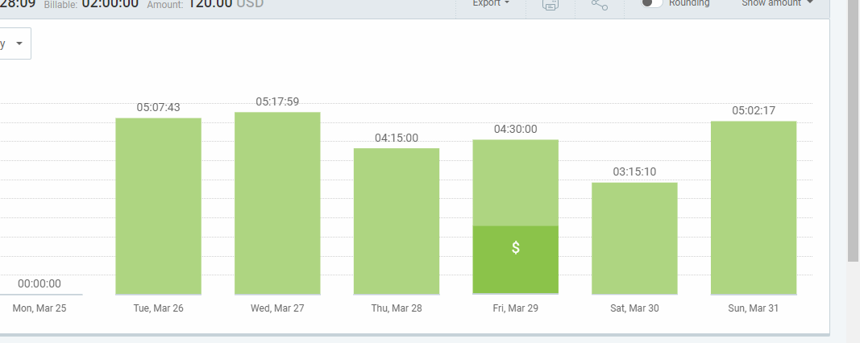
🎨ORGANISATION & Planning

Slide 12
🎨 Social Media & outreach

Slide 13
🎨DATA

Slide 14
Automation + Setup

Slide 15
🎨Knowledge

Slide 16
🎨 Other Platforms

Slide 17
🎨DATA

Slide 18
🎨Knowledge

Slide 19
🏗️PROBLEMS
NO GOOD CI / CD EVIRONMENT YET BUILD – FAILURE OF COTIT

Slide 20
🤝Partnerships
Ayoub

Slide 21
Priority Finding:

Slide 22
FEEDBACK: PollEv.com​/chrisverhoef134

